Slide 1
Academic Poster Design
J. Douglas Willen, Ph.D.
Academic Technologist,
Swarthmore College

Slide 2
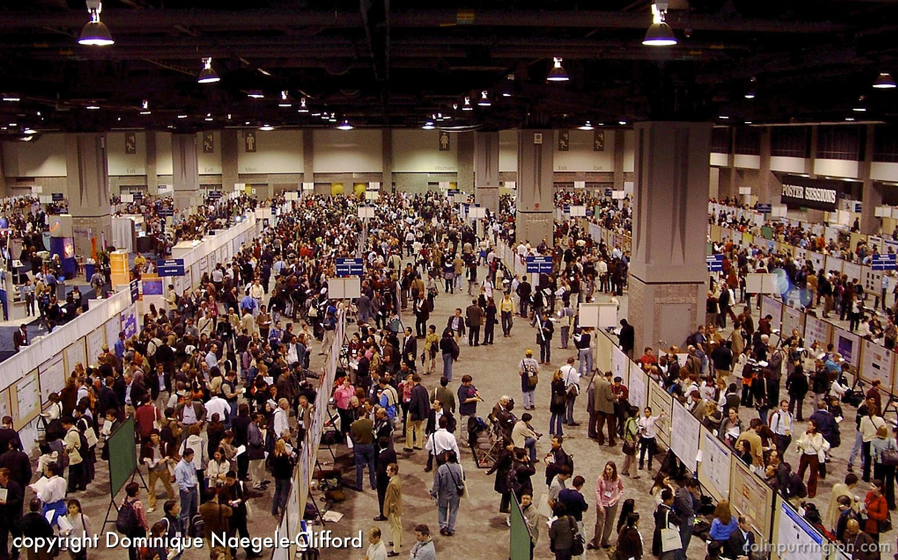
Purpose
Why create a poster?
What are your goals
for the poster?

Slide 3
Why create a poster?
Goals:
  Get attention!
  Generate interest in your work
  Present your most interesting findings & approach (methods), as the support to your story about your work

Slide 4
The Swarthmore Challenge
Swarthmore students typically use too much text (faculty too!)
“Posters with too many words will cause viewers to just read your figures or, more likely, to avoid your poster altogether.”
Colin Purrington (Former Professor of Biology and poster design expert)

Slide 5
Think about professional ads
Notice how advertisers present material in a supermarket or on posters for shows, and online ads.
A poster is very much like a TV ad – you need to grab the viewer’s attention and give them the critical details that make them want to learn more (and then to talk to you!)

Slide 6
Your poster
After getting the attention of the potential reader, your poster serves as the support material for the story you want to present.
It needs to stand on it’s own too, but too much text will make folks avoid your poster!

Slide 7
What’s wrong with this one?

Slide 8
Questions:
What is it about?
Who did the work?
Where is the
introduction?
Can you see anything from 10 feet away?
Can you read the text or maps easily?
What is the Question? Results? Conclusions?

Slide 9
Elements of a good poster
Great Title (e.g. Clickbait!), Then: your name & affiliation
Introduction (Theory)
Describe the relevant concepts & motivation for this work
Issue/Question/Problem:
What, in a few words, are you trying to address?
Procedure (Methods/Analysis): Steps to do the what you did
What did you actually do (Use graphics, illustrations, pictures, if possible)
Results: Presentation of your key insights – Graphics where possible
Take the audience through the stages of your process (photos)
Discussion: How did the principles apply?
Conclusion: Summary, why is it significant, key points, future directions.
References, Acknowledgements (at the bottom)

Slide 10
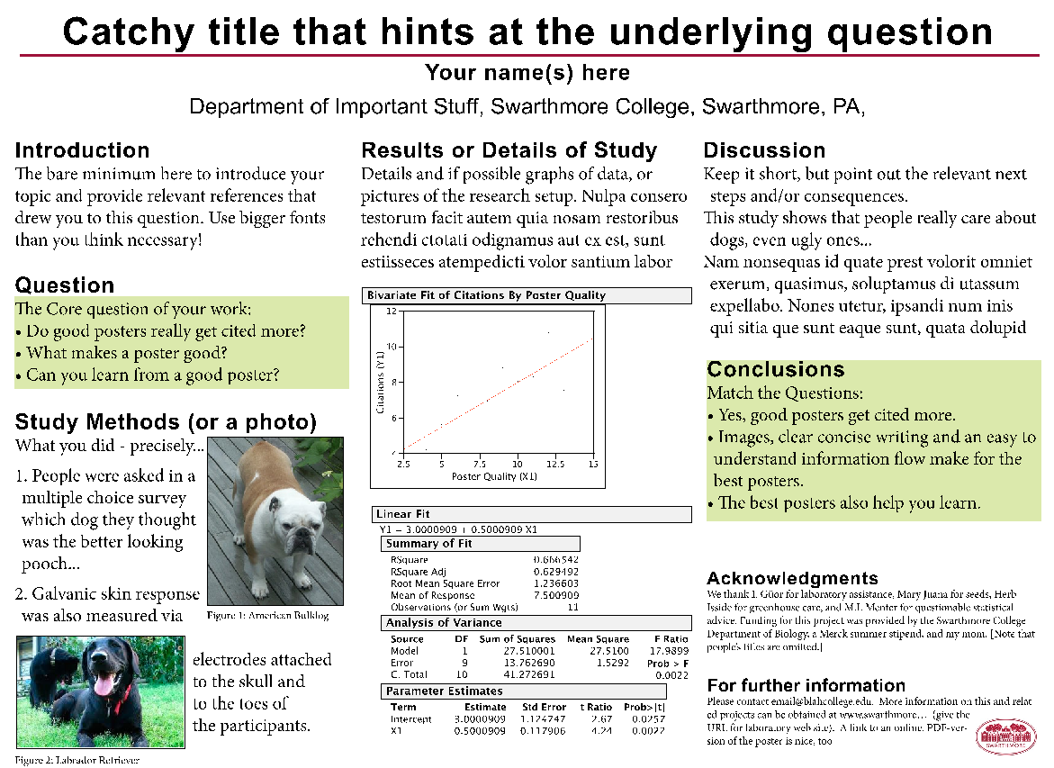
Science
Poster
Note: Some content of this mock-up from Colin Purrington: http://colinpurrington.com/tips/academic/posterdesign (2014)

Slide 11
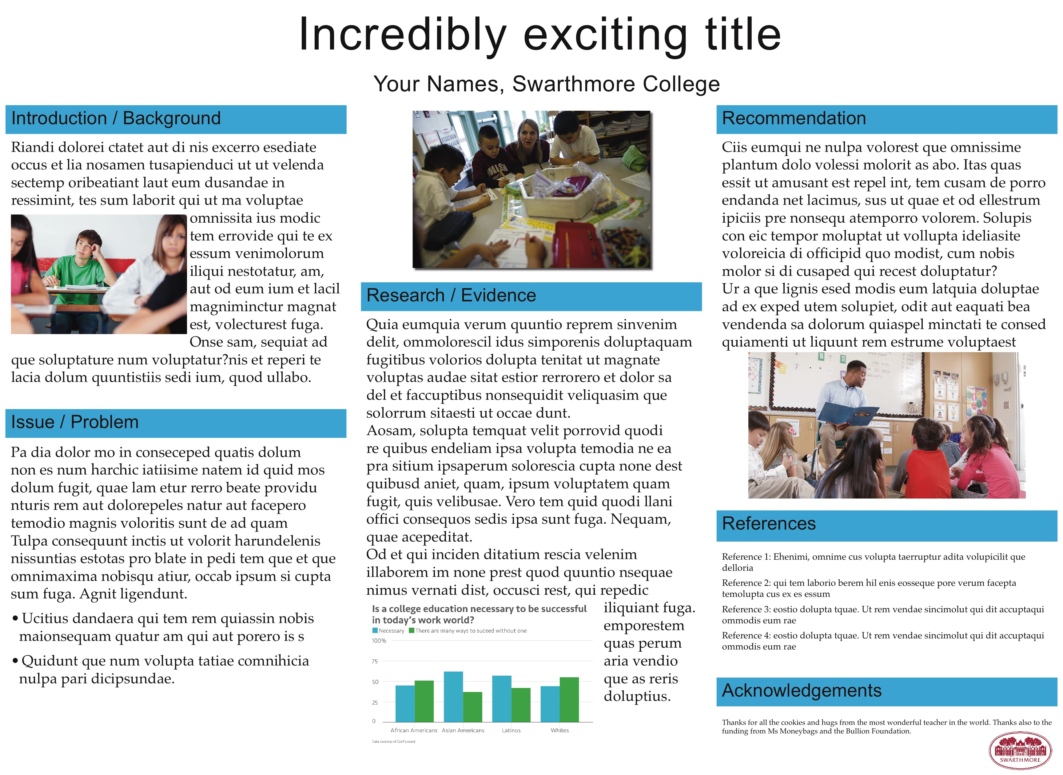
Education Poster

Slide 12
Key Tips
Make information flow from upper left to lower right.
- Top to bottom, left to right - the way we read (English).
It must flow, visually – posters are a VISUAL medium!
Use a san-serif font (Arial, Helvetica) for the titles and headings and a serif font (Times New Roman, Palatino) for the body text – it will make it easier to read both.
Use a standard poster format, or be clear about flow.
Bullet points are ok! (encouraged even)
Present information in chunks, not long blocks of text.

Slide 13
Image tips
Images from the web look bad when blown up. Find high resolution images – so you have at least 150 dpi on the page, which means at least 1500x1500 pixels for a 10” x 10” image.
If you’re using Google image search, make sure you use the Search Tools, and set the size to be large, but watch pixels.
Drop shadows on an image or a thin black or grey border can make your images pop off the page for the viewer.

Slide 14
More tips
Left justify the body text - fully justified is hard to read.
Line things up, or if not, make it a conscious, deliberate choice, with a clear organizational flow.
Spread out the title words a bit with tracking controls.
If you must have tables (try not to), shade every other row.
Use color to make points, highlight things and communicate themes.
Incorporate white space!

Slide 15
Using color
Use contrast, not color, to make words stand out from background. Avoid colored backgrounds – they’re hard to read
Be careful about red/green color combinations for anything – roughly 8% of males have difficulty distinguishing reds from greens (0.5% for women). Other color anomalies are out there!
Color is also useful to highlight major points, such as your abbreviated research question, and your answers to that question.

Slide 16
When printing in the Media Center
Set page dimensions for 35” x 48” for the 36” paper.
Set your color space for RGB - specifically Adobe RGB (1998)
Test your poster on the big screen – can you read it from the other side of the room? (If not, make your text larger!)
Print a copy on 11x17 (tabloid) paper first and have friends comment – if possible, when you’re not around!
Use a white background and black text – easier to read and uses less ink.

Slide 17
Best poster creation tools
We’re partial to Adobe InDesign
  Great control over text, including text flow between text boxes, and around other objects
  Outstanding layout capabilities: Designed for page layout of mostly textual content
Avoid: Powerpoint / Keynote / Prezi / Google Slides!
  Yes, it’s easy to use, but… designed for on screen presentations.
  No good color control, page size limits, limited formatting controls, inflexible.
  Can take longer to print (if you need to save as PDF, then print from Photoshop)
Other tools OK (ie. Illustrator, Photoshop, Inkscape (free), LaTex, OmniGraffle, Quark, Poster Genius), but may need to still print from PDF through Photoshop in the Beardsley Media Center

Slide 18
More resources on poster design
Great (and humorous) advice from a former Swarthmore faculty member (2nd most popular web page at Swarthmore after only the main College web page!):
https://colinpurrington.com/tips/poster-design
Better Posters Blog
https://betterposters.blogspot.com
Mike Morrison on a new way to design posters:
Original: https://youtube.com/watch?v=1RwJbhkCA58
Updated: https://www.youtube.com/watch?v=SYk29tnxASs
Derek Crowe on designing posters with graphic design principles:
https://derekcrowe.net/butterposter
Well put-together introduction to science poster design:
https://www.engineering.cornell.edu/sites/default/files/departments/main%20area/pdf%20files/Scientific%20Posters%2008-2018.ppt

Slide 19
Good detail on various aspects of poster content and design:
http://www.ncsu.edu/project/posters
Color for maps and graphics
https://colorbrewer2.org/
Color Palette Inspiration:
http://www.colourlovers.com/
Color Contrast Information:
http://www.colourlovers.com/web/blog/2010/03/11/calculating-color-contrast-for-legible-text
Color Contrast Checking:
http://snook.ca/technical/colour_contrast/colour.html

Slide 20
Creative Commons:
http://search.creativecommons.org/
Create your own QR code (just one example):
http://qrcode.kaywa.com/

